Slide 1

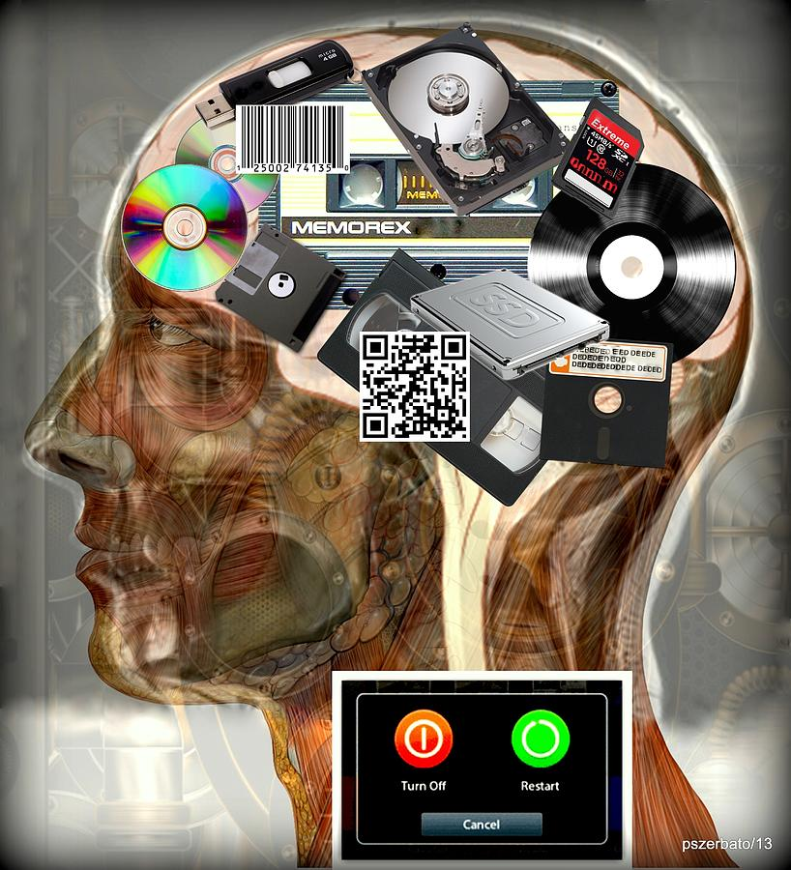
Introduction to Computer Science
Reichman University
Lecture 5-2
Multimedia, Part I
Notes:
‹#›

Slide 2
TOPICS of lecture 5-2:
This lecture focuses on the following topics:
1. Standard Input and Output:
• Concepts of standard output (e.g., using print, println, printf).
• Standard input handling in Java using custom classes like In.
• Examples of redirection (>, <, |) for file and process interaction.
2. Graphics:
• Basics of computer graphics, including the physical and logical view of a canvas.
• Drawing basic shapes like lines and equilateral triangles using the StdDraw class.
• Importance of building and implementing mathematical models for graphical representation.
3. Data Visualization:
• Visualizing geographical data (e.g., city coordinates) by plotting points on a canvas.
• Example implementation using StdDraw to create a visual map of coordinates from a file.
4. Function Plotting:
• Plotting mathematical functions like f(x) = x^2 and f(x) = sin(4x) + sin(20x).
• Scaling canvas dimensions based on function values to ensure proper visualization.
• Understanding the complexity and potential pitfalls of data-driven visuals.
The lecture emphasizes practical programming skills for working with input/output, graphics, and data visualization using Java.

Slide 3
Standard output
Terminal (aka shell / cmd):
public class RandomNumbers {
public static void main(String[] args) {
int N = Integer.parseInt(args[0]);
// Prints N random numbers in [0,1)
for (int i = 0; i < N; i++) {
System.out.println(Math.random());
}
}
}
% java RandomNumbers 5
0.4234137005317864
0.2984657006398488
0.7456080688315734
0.0038273723723723
0.8734883483448448
%
Terminal: An interactive OS program that enables managing files and executing programs, using textual commands
“Standard output”: The stream of characters that a program writes
print / println / printf functions write to standard output
By default: Standard output goes to the terminal.

Slide 4
Standard input
Terminal (aka shell / cmd):
% java Average

Slide 5
Standard input
Terminal (aka shell / cmd):
% java Average
10
20
30
Average: 20.0
%
In each line the user types something and presses “enter” (which produces an “end-of-line” character)
Here the user entered an input termination character: ctrl-d (in mac / unix)
ctrl-z (in windows)

Slide 6
Standard input
Terminal (aka shell / cmd):
/** Reads numbers from standard input and prints their average. */
public class Average {
public static void main(String[] args) {
// Creates an In object for representing standard input
In in = new In();
// Assumption: At least one value
double x = in.readDouble();
int count = 1;
double sum = x;
while (!in.isEmpty()) {
x = in.readDouble();
sum += x;
count++;
}
System.out.println("..." + sum / count);
}
}
% java Average
10
20
30
Average: 20.0
%
In each line the user types something and presses “enter” (which produces an “end-of-line” character)
In: a class for reading inputs
Here the user entered an input termination character: ctrl-d (in mac / unix)
ctrl-z (in windows)
Remember to compile In.java!
“Standard input”: The stream of characters that a program reads; By default, comes from the keyboard.
Java provides no simple way to read inputs from standard input;
In: An open source class for handling standard input, used in this course.

Slide 7
The In class
Modifier and Type | Method | Description
void | close() | Closes this input stream.
boolean | exists() | Returns true if this input stream exists.
boolean | hasNextChar() | Returns true if this input stream has more input (including whitespace).
boolean | hasNextLine() | Returns true if this input stream has a next line.
boolean | isEmpty() | Returns true if input stream is empty (except possibly whitespace).
static void | main​(String[] args) | Unit tests the In data type.
String | readAll() | Reads and returns the remainder of this input stream, as a string.
double[] | readAllDoubles() | Reads all remaining tokens from this input stream, parses them as doubles, and returns them as an array of doubles.
int[] | readAllInts() | Reads all remaining tokens from this input stream, parses them as integers, and returns them as an array of integers.
String[] | readAllLines() | Reads all remaining lines from this input stream and returns them as an array of strings.
long[] | readAllLongs() | Reads all remaining tokens from this input stream, parses them as longs, and returns them as an array of longs.
String[] | readAllStrings() | Reads all remaining tokens from this input stream and returns them as an array of strings.
boolean | readBoolean() | Reads the next token from this input stream, parses it as a boolean (interpreting either "true" or "1" as true, and either "false" or "0" as false).
byte | readByte() | Reads the next token from this input stream, parses it as a byte, and returns the byte.
char | readChar() | Reads and returns the next character in this input stream.
double | readDouble() | Reads the next token from this input stream, parses it as a double, and returns the double.
float | readFloat() | Reads the next token from this input stream, parses it as a float, and returns the float.
int | readInt() | Reads the next token from this input stream, parses it as a int, and returns the int.
String | readLine() | Reads and returns the next line in this input stream.
long | readLong() | Reads the next token from this input stream, parses it as a long, and returns the long.
short | readShort() | Reads the next token from this input stream, parses it as a short, and returns the short.
String | readString() | Reads the next token from this input stream and returns it as a String.

Slide 8
Redirection
(Previous examples):
Redirection examples:
% java RandomNumbers 3
0.4234137005317864
0.2984657006398488
0.7456080688315734
% java Average
100
200
100
300
<ctrl-d> / <ctrl-z>
Average: 175.0
%
% java RandomNumbers 1000 > data.txt
% more data.txt (more: OS command for viewing a file)
0.05589098017497873
0.5792882827583564
...
% java Average < data.txt
Average: 0.48881491492997764
% java RandomNumbers 1000000 | java Average
Average: 0.4999861238602861
%
Redirection operators
> fileName: Directs standard output to a file
< fileName: Directs standard input from a file
process1 | process2: Pipes the output of process1 into the input of process2

Slide 9
Graphics
Computer graphics: The art and science of displaying and manipulating images
The science: Building a mathematical model
The art: Implementing the model using a library of graphics primitives: draw a point, draw a line, draw a circle, etc.
StdDraw: An open source graphics class, used in this course.

Slide 10
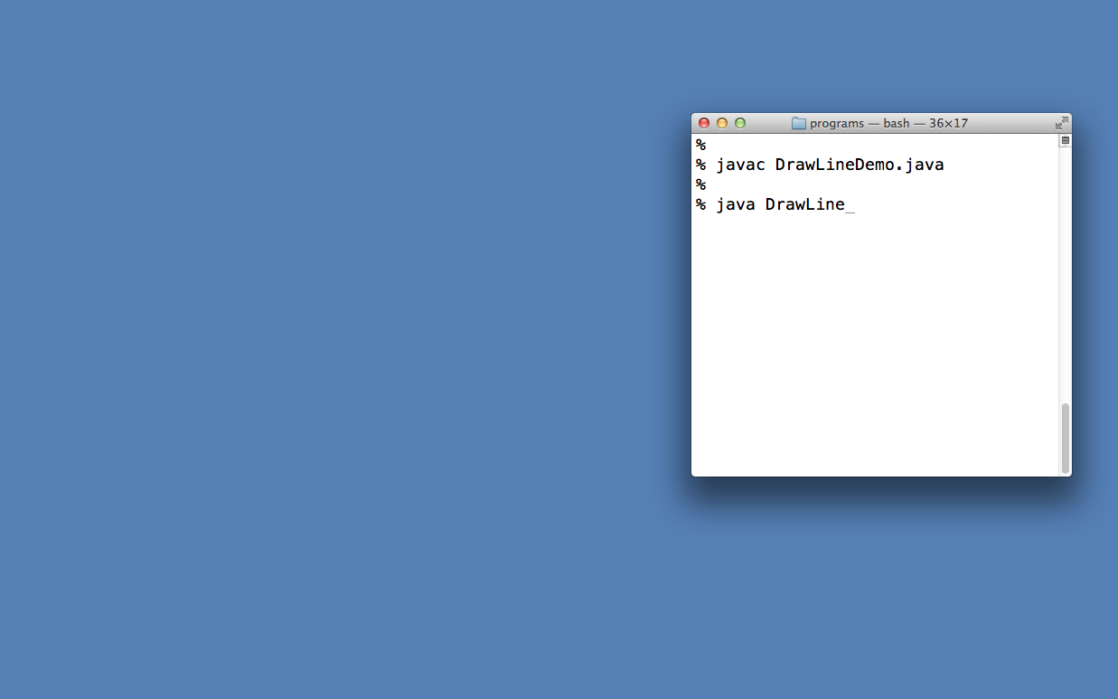
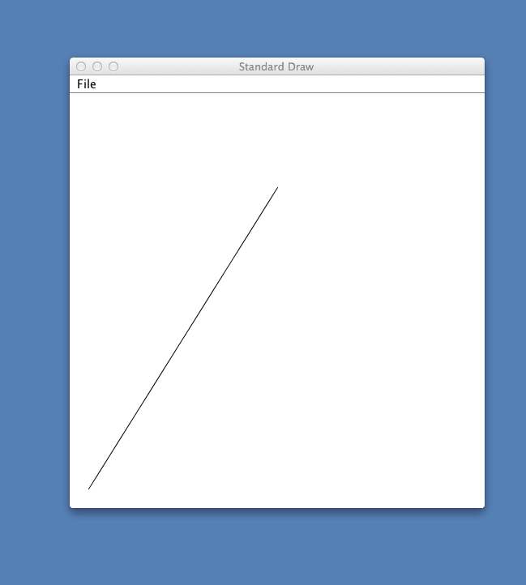

“Canvas” (drawing area)
(0.5, 0.8)
1.0
Screen
canvas
(0, 0)
(0, 0)
1.0
1.0
Physical view: a ”canvas” consisiting (by default) of 512 rows of 512 pixels each, which includes an invisible 10-pixel all around “frame”
Logical view: a 1.0 by 1.0 coordinate system, (0,0) at the bottom-left corner.

Slide 11
Line drawing
public class DrawLineDemo {
public static void main(String[] args) {
// draws a line between (0,0) and (0.5,0.8)
StdDraw.line(0.0, 0.0, 0.5, 0.8);
}
}
Notes:
StdDraw creates a default canvass
The default canvas dimensions, line width, colors, etc. can be easily changed using StdDraw functions.
(0.5, 0.8)
Note: to kill a program that creates a graphical window, close the window
(0, 0)

Slide 12
Line drawing
Task: Draw an equilateral triangle with side length 1; Left bottom corner at (0,0).
public class EqTriangle {
public static void main(String[] args) {
//// You do it, using StdDraw.drawLine()

Slide 13
The StdDraw class
Modifier and Type | Method | Description
void | actionPerformed​(ActionEvent event) | This method cannot be called directly.
static void | arc​(double x, double y, double radius, double angle1, double angle2) | Draws a circular arc of the specified radius, centered at (x, y), from angle1 to angle2 (in degrees).
static void | circle​(double x, double y, double radius) | Draws a circle of the specified radius, centered at (x, y).
static void | clear() | Clears the screen using the default background color (white).
static void | clear​(Color color) | Clears the screen using the specified background color.
static void | close() | Closes the standard drawing window.
static void | disableDoubleBuffering() | Disables double buffering.
static void | ellipse​(double x, double y, double semiMajorAxis, double semiMinorAxis) | Draws an ellipse with the specified semimajor and semiminor axes, centered at (x, y).
static void | enableDoubleBuffering() | Enables double buffering.
static void | filledCircle​(double x, double y, double radius) | Draws a filled circle of the specified radius, centered at (x, y).
static void | filledEllipse​(double x, double y, double semiMajorAxis, double semiMinorAxis) | Draws a filled ellipse with the specified semimajor and semiminor axes, centered at (x, y).
static void | filledPolygon​(double[] x, double[] y) | Draws a filled polygon with the vertices (x₀, y₀), (x₁, y₁), ..., (x_{n–1}, y_{n–1}).
static void | filledRectangle​(double x, double y, double halfWidth, double halfHeight) | Draws a filled rectangle of the specified size, centered at (x, y).
static void | filledSquare​(double x, double y, double halfLength) | Draws a filled square of the specified size, centered at (x, y).
static Color | getBackgroundColor() | Returns the current background color.
static Font | getFont() | Returns the current font.
static Color | getPenColor() | Returns the current pen color.
static double | getPenRadius()

Slide 14
Data visualization
Given: Geographical coordinates of 13000+ cities and villages (with population > 500)
Task: Make the data visible
convention: first 4 values are the
data’s xMin, yMin, xMax, yMax
% more USA.txt
669905.0 247205.0 1244962.0 700000.0
1097038.8890 245552.7780
1103961.1110 247133.3330
1104677.7780 247205.5560
1108586.1110 249238.8890
...
% java PlotMap USA.txt

Slide 15
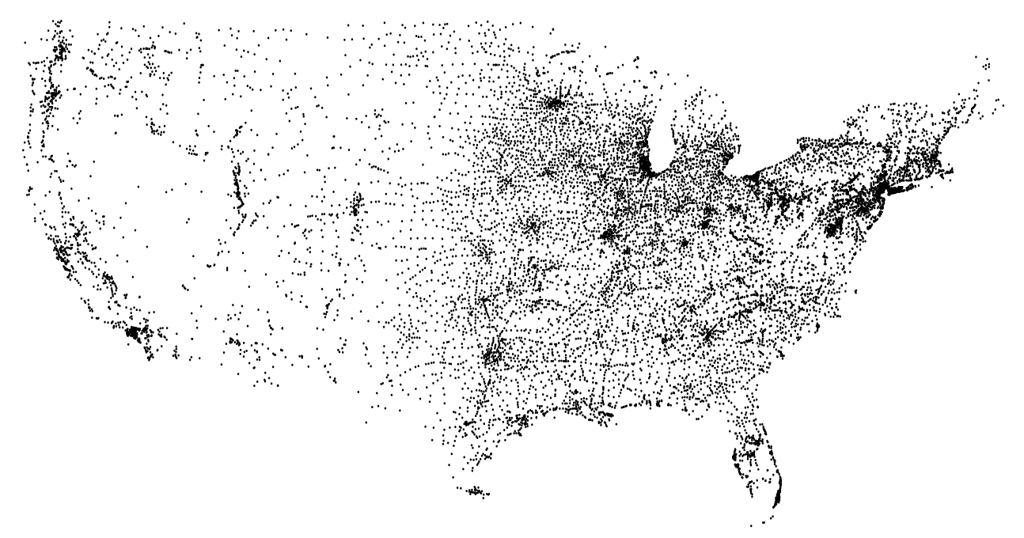
Data visualization
Given: Geographical coordinates of 13000+ cities and villages (with population > 500)
Task: Make the data visible
convention: first 4 values are the
data’s xMin, yMin, xMax, yMax
/** Reads data points (geographical coordinates) from a file,
* and draws them. */
// Uses classes In, StdDraw
public class PlotMap {
public static void main(String[] args) {
In in = new In(args[0]); // Input file reader
// Sets the canvass physical dimensions to // a fixed “landscape” frame
StdDraw.setCanvasSize(1000,800); // (width,height)
// Scales the canvass logical dimensions according
// to the min and max values in the data
double xMin = in.readDouble();
double yMin = in.readDouble();
double xMax = in.readDouble();
double yMax = in.readDouble();
StdDraw.setXscale(xMin, xMax);
StdDraw.setYscale(yMin, yMax);
// Draws the data points
while (!in.isEmpty()) {
StdDraw.point(in.readDouble(),
in.readDouble());
}
}
}
% more USA.txt
669905.0 247205.0 1244962.0 700000.0
1097038.8890 245552.7780
1103961.1110 247133.3330
1104677.7780 247205.5560
1108586.1110 249238.8890
...
% java PlotMap USA.txt
1200 by 800 pixels canvas
yMax
yMin
xMin
xMax

Slide 16
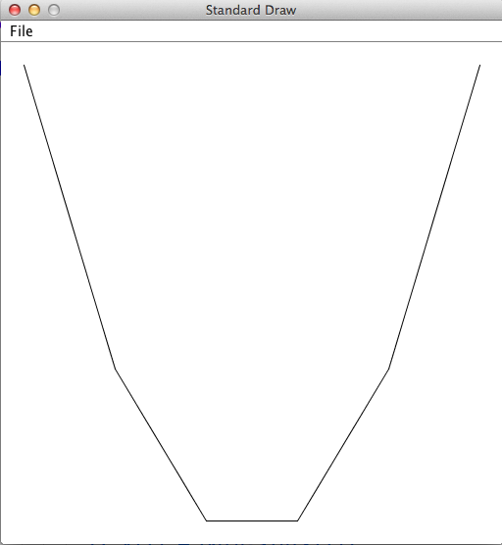
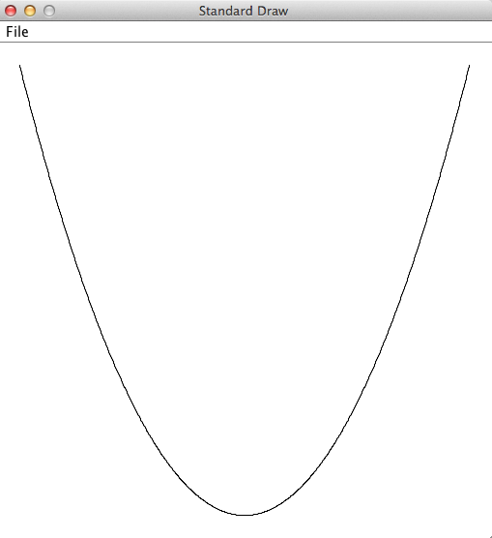
Function plotting
Function to draw: Hard-coded into the program
Range (xMin, xMax): command-line arguments
N (number of segments): command-line argument
Plot f (x) = x²
xMin
xMax
N
% java PlotFunction -100 100 5
% java PlotFunction -100 100 1000

Slide 17
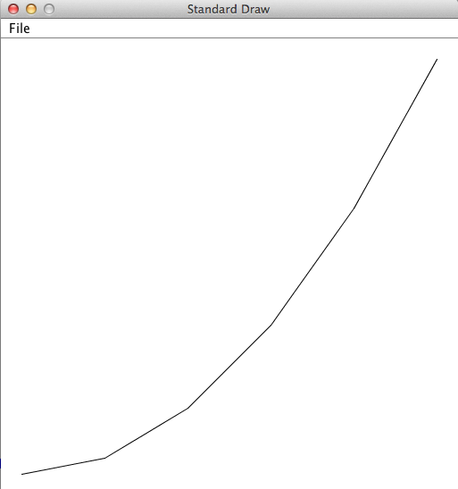
Function plotting
xMin
xMax
N
Plot f (x) = x²
% java PlotFunction 0 100 5

Slide 18
Function plotting
/** Plots functions. */
public class PlotFunction {
// The function to plot: f(x) = x * x
public static double f(double x) {
return x * x;
}
public static void main(String[] args) {
double xMin = Double.parseDouble(args[0]);
double xMax = Double.parseDouble(args[1]);
int N = Integer.parseInt(args[2]);
// Creates arrays for the x values and y values
double x[] = xArr(xMin, xMax, N);
double y[] = f(x);
// Scales the canvas
StdDraw.setXscale(xMin, xMax);
StdDraw.setYscale(min(y), max(y));
// Connects the (x,y) points
for (int i = 0; i < N; i++) {
StdDraw.line(x[i], y[i], x[i+1], y[i+1]);
}
}
//// More functions: On the right of this slide
}
// Returns an array that represents the x-axis (x ציר ה-): // N equally-spaced points between a and b
public static double[] xArr(double a, double b, int N) {
double[] x = new double[N + 1];
double interval = (b - a) / N;
for (int i = 0; i <= N; i++) {
x[i] = a + (i * interval);
}
return x;
}
// Returns the array f(x[])
public static double[] f(double x[]) {
int N = x.length;
double[] y = new double[N];
for (int i = 0; i < N; i++) {
y[i] = f(x[i]); // computes y = f(x)
}
return y;
}
// Returns the minimum value in the given array (code omitted)
public static double min(double arr[]) {
}
// Returns the maximum value in the given array (code omitted)
public static double max(double arr[]) {
}
}

Slide 19
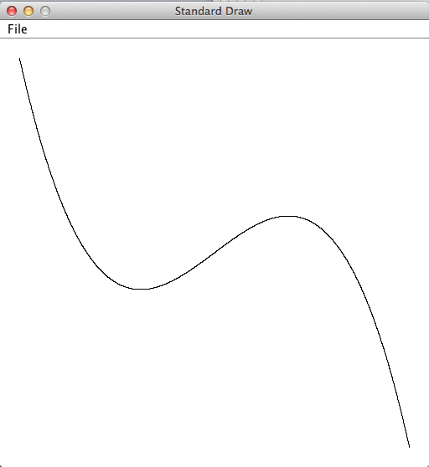
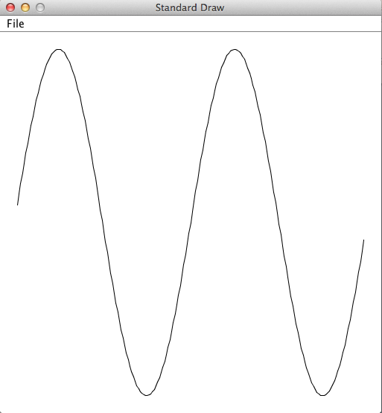
Function plotting
Plot f (x) = –7x³ + 3x + 2
% java PlotFunction -2 2 100
% java PlotFunction -6.28 6.28 100

Slide 20
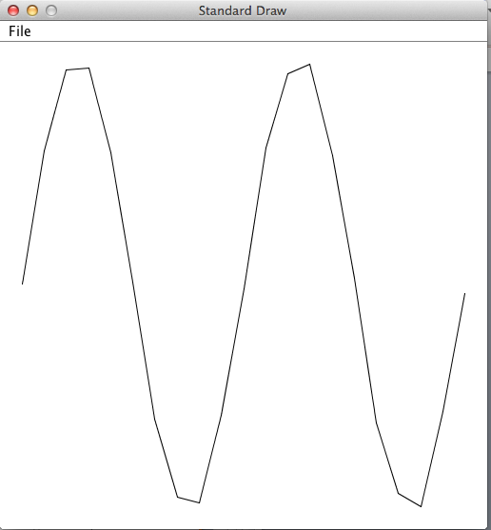
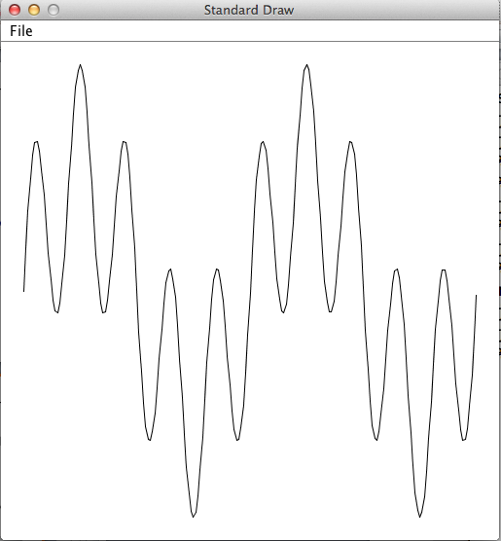
Function plotting
Plot
public class PlotFunction {
// The function to plot: f(x) = sin(4x) + sin(20x)
public static double f(double x) {
return Math.sin(4*x) + Math.sin(20*x);
}
public static void main(String[] args) {
...
% java PlotFunction 0 3.14 20
% java PlotFunction 0 3.14 200
One lesson...
visual imaging of data (like linear interpolation) can be tricky;
when shown a data-driven visual, always demand to see the data.

